Slide 1
INTRODUCTION TO WEB APPLICATION DEVELOPMENT
TJ 3043
Web Application Development

Slide 2
Contents
Introduction to WWW
Web Application Development

Slide 3

Application Architecture Evolution
Three distinct era’s of application architecture
  mainframe (1960’s and 70’s)
  personal computer era (1980’s)
  We era (1990’s onwards)

Slide 4
Introduction to WWW

Slide 5
WWW History
1989 - Birth of WWW
  Tim Berners-Lee & his associates at CERN
1990 - First Web Browser
  Used within CERN
1991 - Public offering of WWW
1993 - Birth of Mosaic
  Graphical, multimedia browser from NCSA
1994 - First commercial browser
  By Netscape communications founded by Jim Clark and Marc Andreessen

Slide 6
Web Advantages
Creates a virtual hyperspace
  Beyond geographical constraints
  Break computer hardware and software obstacles
  Bring the whole world together
A low cost way to Share, maintain, and distribute
Information
  Intranet
  Electronic commerce
  Customer support

Slide 7
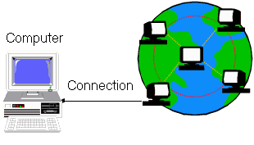
Web Client (browser)
Internet

Slide 8
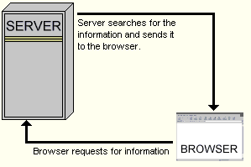
Web Server

Slide 9
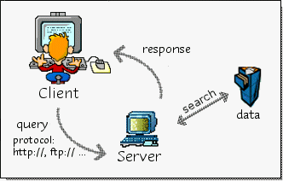
Web Surfing (Logical View)

Slide 10
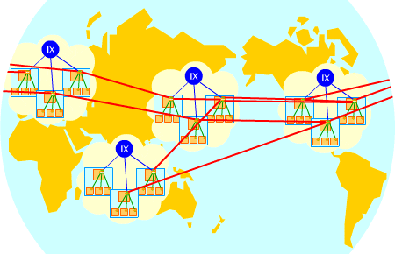
Web Surfing (Network View)

Slide 11
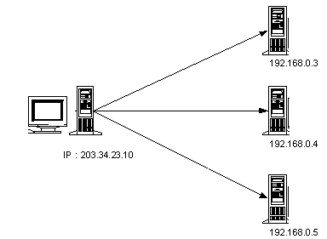
Establishing Communication

Slide 12
Network Basis
TCP/IP protocol
  Transmission Control Protocol and Internet Protocol
  Specifies how two computer exchange data
HTML
  Content-based or structural markup language, where the codes describe what the contents of the document are.
  Codes are used to indicate the various parts of the document, such as headings, paragraphs, lists, etc
IP address
  Every computer has a unique IP address
  32 bits in three 8 bit number groups
  131.96.142.17

Slide 13
Network Basis
Domain name system (DNS)
  Symbolic name for IP address
  stm1.uum.edu.my
  Communication is established by mapping a domain
  name to its IP address
URL
  Internet address consist of
    protocol
    host name
    path

Slide 14
URL
Abbreviation of Uniform Resource Locator, the global address of documents and other resources on the World Wide Web.
The first part of the address indicates what protocol to use, and the second part specifies the IP address or the domain name where the resource is located.
For example, the two URLs below point to two different files at the domain pcwebopedia.com. The first specifies an executable file that should be fetched using the FTP protocol; the second specifies a Web page that should be fetched using the HTTP protocol:
  ftp://www.pcwebopedia.com/stuff.exe
  http://www.pcwebopedia.com/index.html

Slide 15
URL
<protocol> <host name> <path>
HTTP--Hypertext Transfer Protocol
  Protocol for accessing World Wide Web documents
FTP--File Transfer Protocol
  Protocol for transferring files from one computer to another
Gopher
  Protocol for accessing documents via Gopher menus (archaic; no longer widely used)
Telnet
  Protocol that allows users to logon to a remote computer

Slide 16
URL Host Name
<protocol> <host name> <path>
<host>.<organization>.<org type>
    www.uum.edu.my
    www.google.com
    www.acm.org
    www.jpa.gov.my

Slide 17
Organization Types
.org : non-profit organizations
.com : commercial hosts
.net : network hosts
.edu : educational institutions
.int : international treaty organizations
.gov : government agencies and organizations
.mil : U. S. military

Slide 18
URL Examples
Full URL
  http://www.uum.edu.my/welcome.htm
  http://www.stm1.uum.edu.my/index.html
  http://www.maxis.net.my/
  http://www.lhdn.gov.my/
Not all characters can be used in URL

Slide 19

Three-Layer Web Architecture

Slide 20
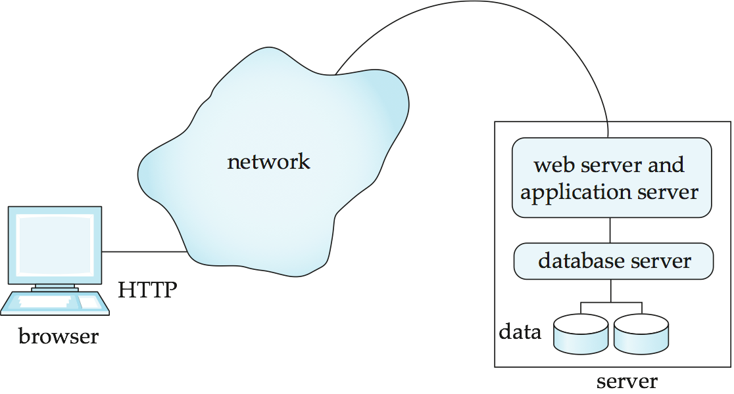
Two-Layer Web Architecture
Multiple levels of indirection have overheads
  Alternative: two-layer architecture

Slide 21
MIME Typing System
Multipurpose Internet Mail Extensions
A file type naming system on the Internet
  .html (or .htm), .gif, .mpeg, .xls
Allow a browser to determine how to work correctly with given files
  Handle by the browser itself
  Call a helper application
  Example: use Adobe Acrobat to read .PDF files
  use Microsoft Excel to read .xls files

Slide 22
10 minutes break
Web 1.0
Web 2.0
Web 3.0

Slide 23
Web Application Development

Slide 24
Static VS Dynamic
HTML documents are usually static
The contents can only be changed manually
There are needs for dynamic documents
  Search results
  Database access
  Context sensitive reply
Static
  page appears exactly as it was encoded, nothing changes
Dynamic
  page is compiled, or able to be changed

Slide 25
Dynamic Web pages
Applications executed by the server at run-time to process client input or generate document in response to client request
Generating dynamic Web pages requires programming

Slide 26
Scripts: Server-Side VS Client-Side
Server-side
  the first type possible on the Web
  action occurs at the server
Client-side
  generally easier to implement
  may be prepared and implemented offline
  action occurs on the client side (browser)

Slide 27
Client-Side Scripting
Client side scripts are embedded inside HTML document. They are interpreted by browser.
When Web browser encounters a script, it calls a scripting interpreter, which parses and deciphers the scripting code.
Provide response to questions and queries without interventions from the server
  Validate user data
  Calculate expressions
  Link to other applications

Slide 28
Client-Side Scripting
Client side advantages
  Faster response time
  Better animation
  Simpler server programs
Client side disadvantages
  Longer load time
  Browser compatibility
  Complexity in web page design

Slide 29
JavaScript
JavaScript (most common)
  a scripting language for Web pages, developed by Netscape in 1995
  JavaScript code is embedded directly in HTML (interpreted by browser)
  good for adding dynamic features to Web page, controlling forms and GUI
Advantage
  Easy to learn and use
  Wide browser support
  Protection of local resources
Disadvantage
  Browser compatibility issues
  Not object oriented
  Unable to gain access to local resources
Notes:
The book I read mentioned that both Java script and Vbscript are object based.

Slide 30
Java Applet
Java applets
– (can be server-side or client-side_
  can define small, special-purpose programs in Java called applets
  provides full expressive power of Java (but more overhead)
  applets are included in Web pages using special HTML tags
  interpreted by the Java Virtual Machine embedded in the browser
  good for more complex tasks or data heavy tasks, such as graphics

Slide 31
Example
Visit this site
Java Applet
http://www.frontiernet.net/~imaging/graph_my_equation.html
http://www.langara.bc.ca/mathstats/resource/onWeb/precalculus/quadratics/index.htm#
Java Script
http://www.hostsrv.com/webmab/app1/MSP/quickmath/02/pageGenerate?site=quickmath&s1=graphs&s2=equations&s3=basic

Slide 32
Java Applet
Advantage
  High functionality
  Object oriented and full graphics functionality
  Protection of local resources
  Wide Browser support
  With Java2, be able to gain access to local resources with signed applets
Disadvantage
  JVM compatibility issues
  Difficulty to install and configure for local access
  Loading time and performance may be poor for large application.

Slide 33
Server-Side Scripting
Advantages
Allows creation of dynamic web pages
Modifies HTML code on the server before sent to client
Uses databases such as Access and Oracle
Responds to user input
Disadvantages
More complicated then HTML (with debugging)
Slower to load on the server
Harder to learn
Web server must be enabled

Slide 34
Examples of Server-Side Scripts
CGI (Common Gateway Interface)
  A standard for interfacing external applications with information servers, such as HTTP or Web servers
  CGI program is any program designed to accept and return data that conforms to the CGI specification
  CGI program can be written in any language that allows it to be executed on the system, such as: C/C++, Fortran, PERL, TCL, Any Unix shell, Visual Basic, AppleScript etc.
PHP (Hypertext Preprocessor )
Widely-used Open Source general-purpose scripting language that is especially suited for Web development and can be embedded into HTML.

Slide 35
Examples of Server-Side Scripts
Active Server Pages (Microsoft)
  ASP is a Microsoft Technology and run on IIS (Internet Information Server) & PWS (Personal Web Server)
Java Server Pages (Sun)
  Sun's solution for developing dynamic web sites
  JSP enable the developers to directly insert java code into jsp file, this makes the development process very simple and its maintenance also becomes very easy

Slide 36
Web Development Tools
Many high-level tools exist for creating Web pages
  e.g., Microsoft FrontPage, Netscape Composer, Adobe PageMill, Macromedia DreamWeaver,
  also, many applications have "save to HTML" options (e.g., Word)

Slide 37
Application Architectures
Application layers
  Presentation or user interface
    model-view-controller (MVC) architecture
      model: business logic
      view: presentation of data, depends on display device
      controller: receives events, executes actions, and returns a view to the user
  business-logic layer
    provides high level view of data and actions on data
      often using an object data model
    hides details of data storage schema
  data access layer
    interfaces between business logic layer and the underlying database
    provides mapping from object model of business layer to relational model of database

Slide 38

Application Architecture

Slide 39
Business Logic Layer
Provides abstractions of entities
  e.g. students, instructors, courses, etc
Enforces business rules for carrying out actions
  E.g. student can enroll in a class only if she has completed prerequsites, and has paid her tuition fees
Supports workflows which define how a task involving multiple participants is to be carried out
  E.g. how to process application by a student applying to a university
  Sequence of steps to carry out task
  Error handling
    e.g. what to do if recommendation letters not received on time
  Workflows discussed in Section 26.2

Slide 40
RESOURCES
S. Hong. Lecture Notes on Web Application Development. Georgia State University. URL : http://www.cis.gsu.edu/~shong/teaching/cis849
HTML Forms & Scripts. URL : http://www.aworc.org/went2001/tracks/joint/ t1t3-forms-scripts-cs.ppt
Web Programming. URL: http://www.creighton.edu/~davereed/csc551.S02/ Lectures/basicHTML.pdf

Slide 41
Secure Servers
Since HTTP messages typically travel over a public network, private information (such as credit card numbers) should be encrypted to prevent eavesdropping
https URL scheme tells browser to use encryption
Common encryption standards:
  Secure Socket Layer (SSL)
  Transport Layer Security (TLS)

Slide 42
Secure Servers
Browser
TLS/
SSL
TLS/
SSL
Web
Server
I’d like to talk securely to you (over port 443)
HTTP
Requests
HTTP
Requests
Here’s my certificate and encryption data
Here’s an encrypted HTTP request
Here’s an encrypted HTTP response
Here’s an encrypted HTTP request
HTTP
Responses
HTTP
Responses
Here’s an encrypted HTTP response

Slide 43
RESOURCES
Introduction To Internet Research :
URL http://lscc.cc.fl.us/library/lis2004/
Network-based application architecture.
URL : http://www.sis.uncc.edu/~billchu/classes/ spring02/itis5166/appArch.ppt
Server-Side Scripting. URL: http://fourh.ucdavis.edu/compcorps/workshops/ I-6/Server-Side%20Scripting.ppt

